Slide 1
COVID-19 in the USA
An investigation into the risk of Covid 19 associated deaths within the United States of America

Slide 2
How I got interested in this study
There have been many arguments saying that California is doing very well because of mask mandates, vaccination rates and shutdown procedures done in the wake of SARS-CoV-2
On the other hand critics have said the opposite and that Florida should be the model state for it’s allowance of freedom and the fact that they have less cases than overbearing states like California

Slide 3
Sources of data
Datahub.io/core/covid-19#data
A collection of data from
John’s Hopkins University,
The World Health Organization,
United States Center of Disease control, The COVID Tracking Project,
NYC Department of Health,
Florida Department of Public health
… and many others
The United States CDC Covid 19 database
Vaccination rates per county in the USA
The US Census
2021 Data on current US population per county
Wikipedia
Information about populations and locations of various counties within the US

Slide 4
Data
3342 different counties and municipalities in the United States
Daily COVID cases and deaths from January 1 2020-2022
Vaccine records from January 1 2021-2022
Includes Partial, Booster and Complete vaccinations per county and % of each county covered
Longitude and Latitude data for each county/municipality

Slide 5
Exploratory analysis

Slide 6
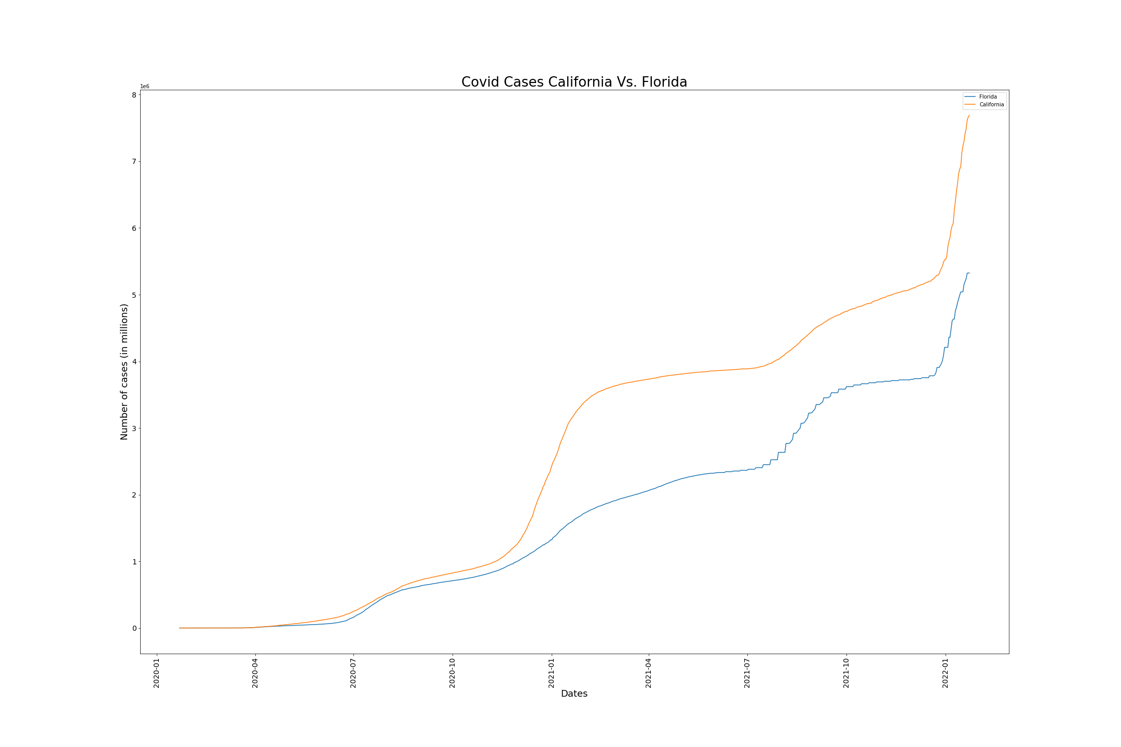
California vs Florida
But Populations:
CA = 39.5 Million
FL = 21.5 Million

Slide 7
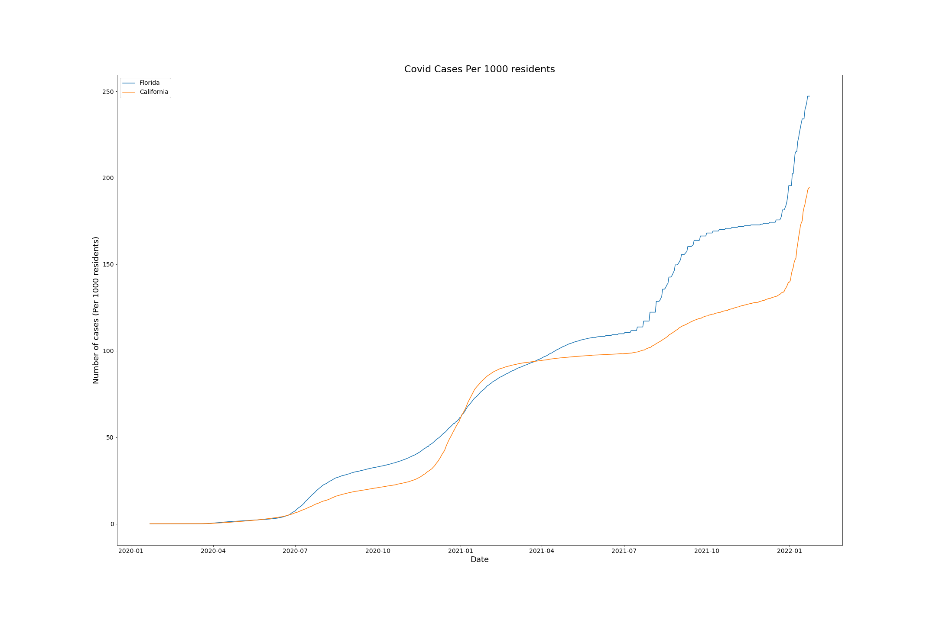
Total Cases of COVID 19 CA vs FL by Population
Per pop CA
Appears to be
Doing better

Slide 8
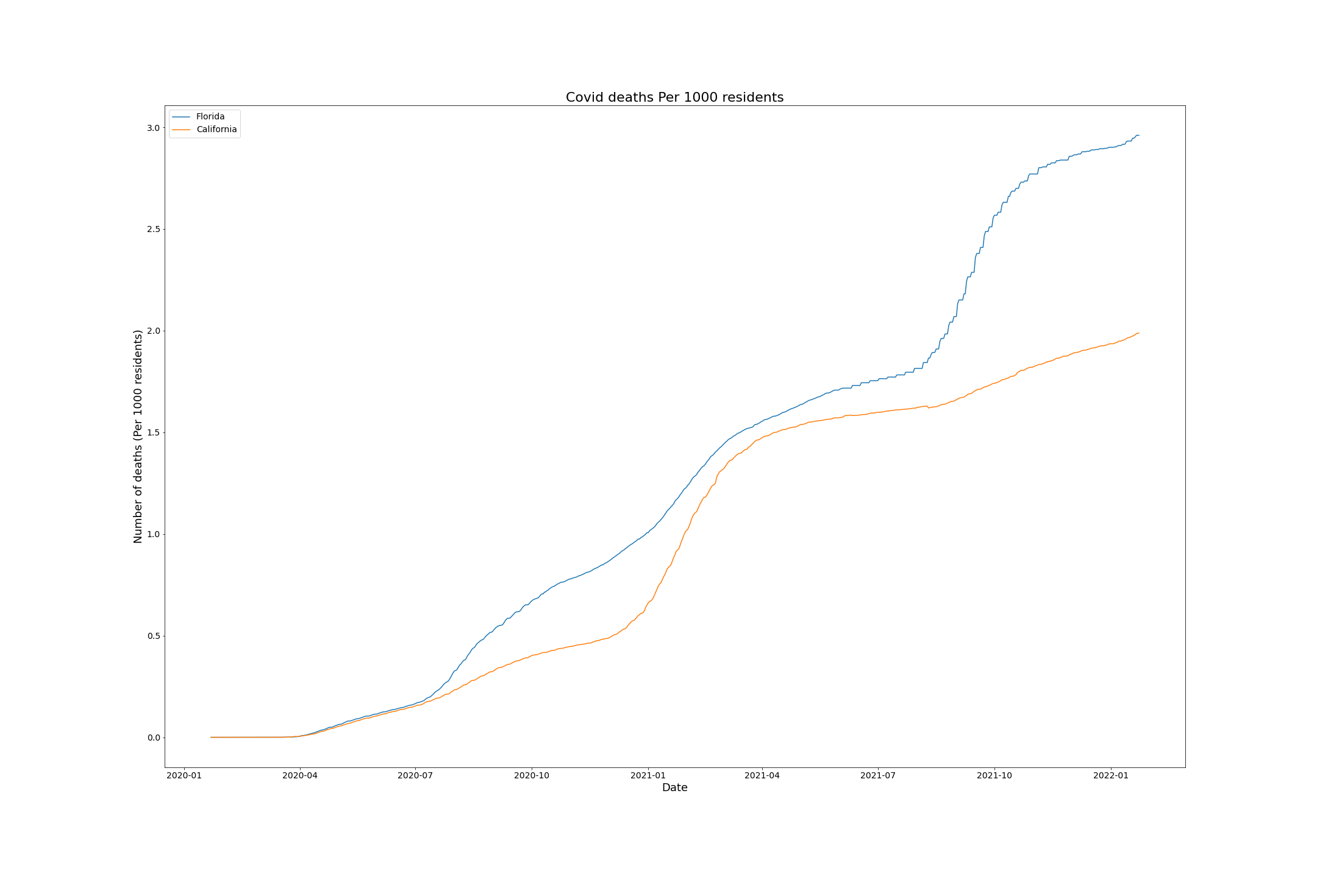
Total Deaths in CA vs FL by Population
150% more deaths
In FL per 1000 than
CA

Slide 9
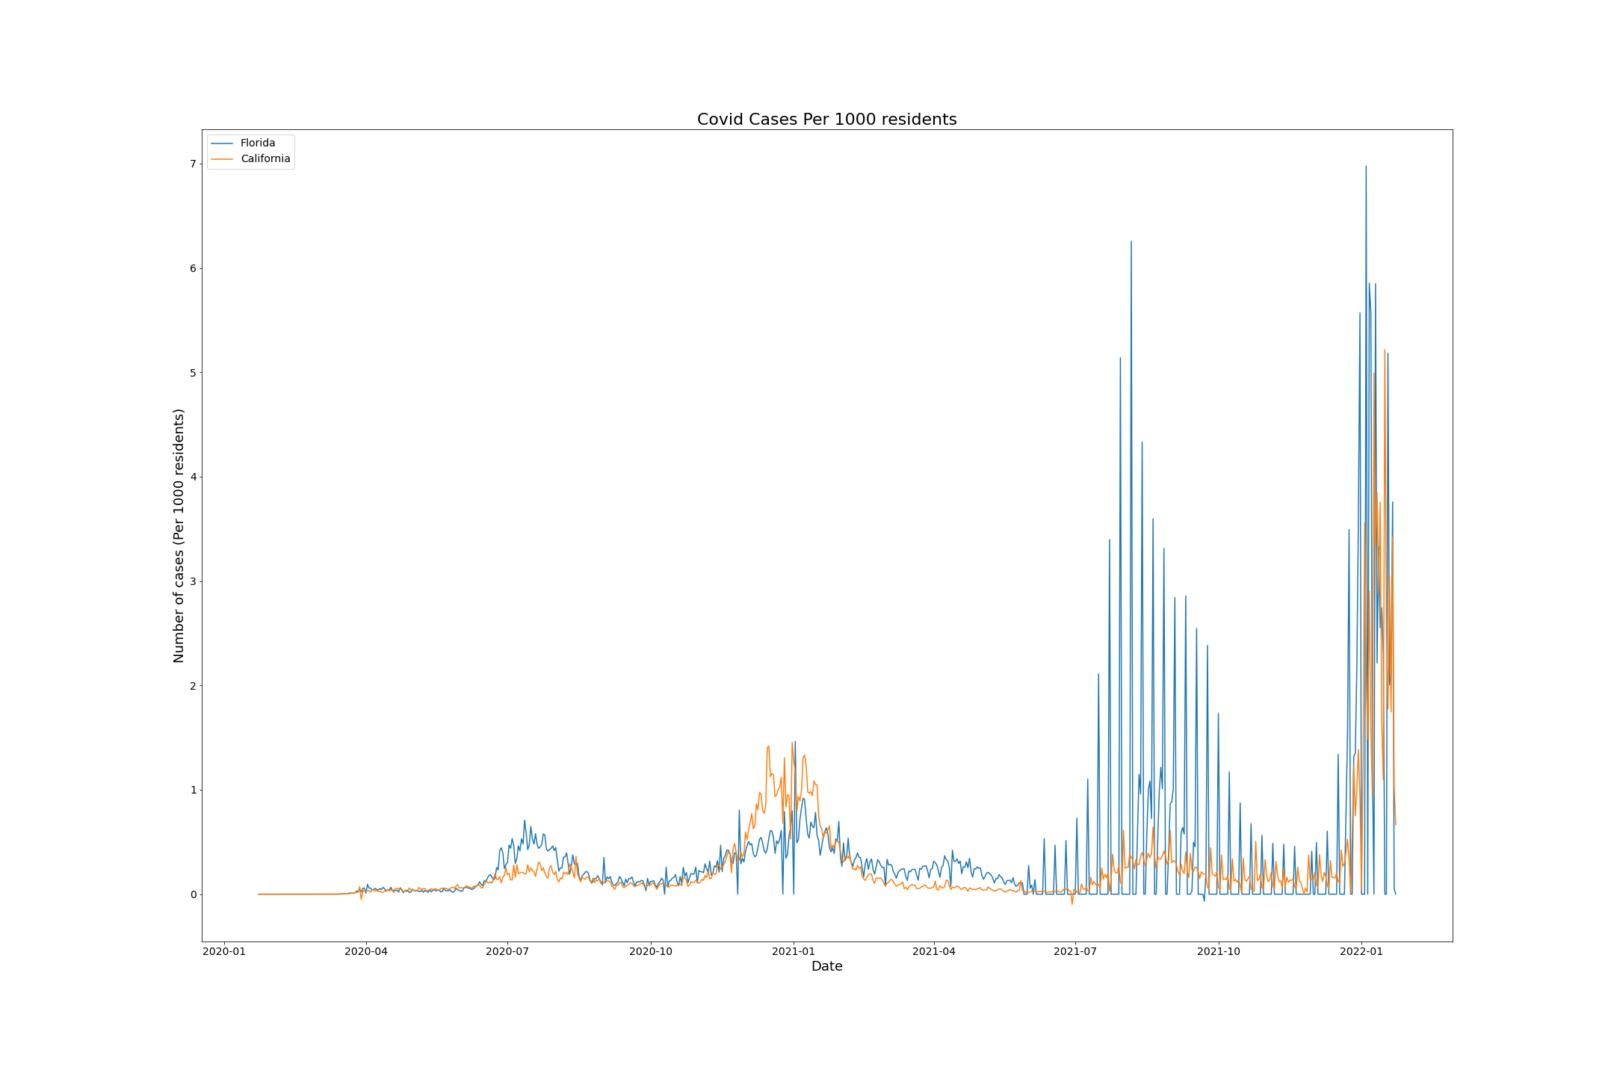
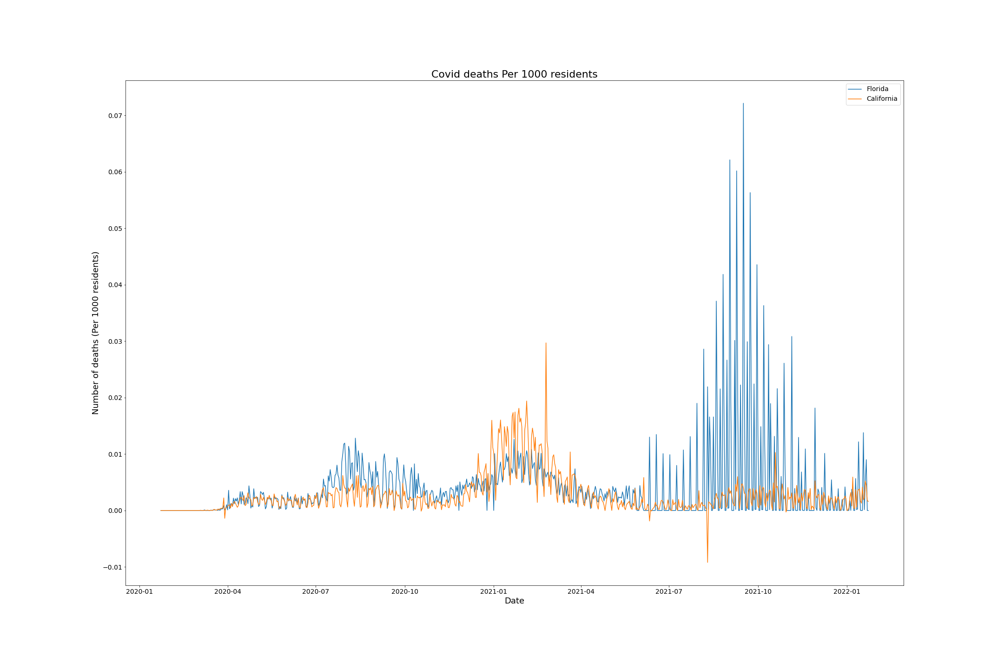
Daily Tally of Cases and Deaths California vs Florida per 1000 Residents
Vaccines
Delta
Omicron
Vaccines
Delta
Omicron
Alpha
Shutdown
Alpha
Shutdown

Slide 10
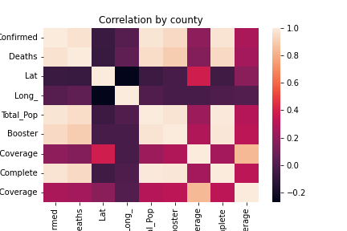
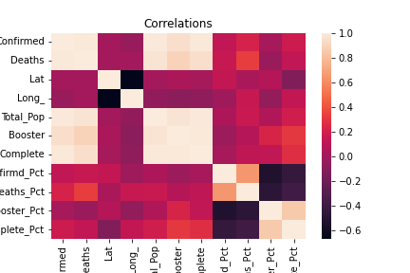
Correlational data shows high correlation between number of cases and deaths
Notes:
Legends are cut off
Fix them or replace them with text

Slide 11
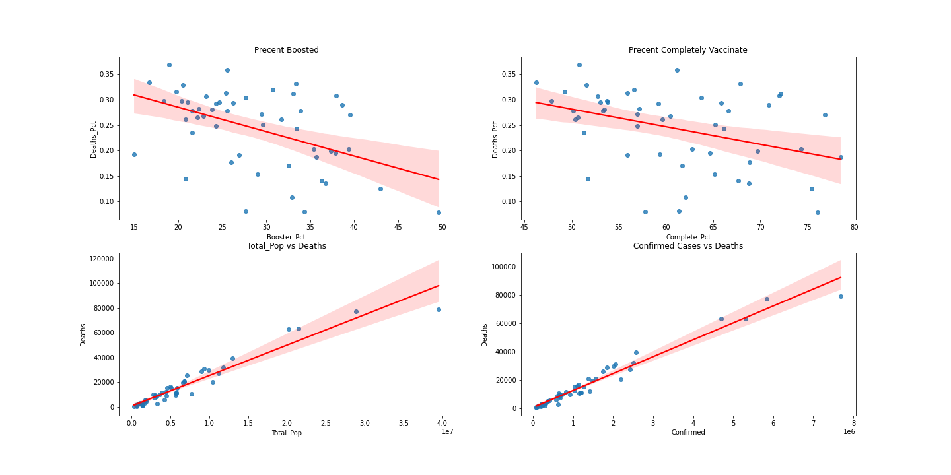
Correlations between Vaccination rates and population rates

Slide 12
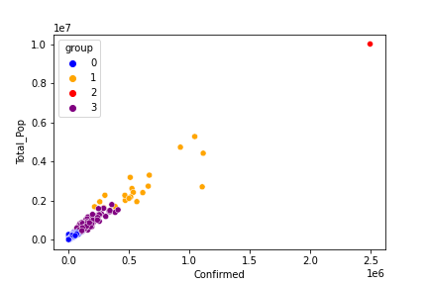
KNN Clustering

Slide 13
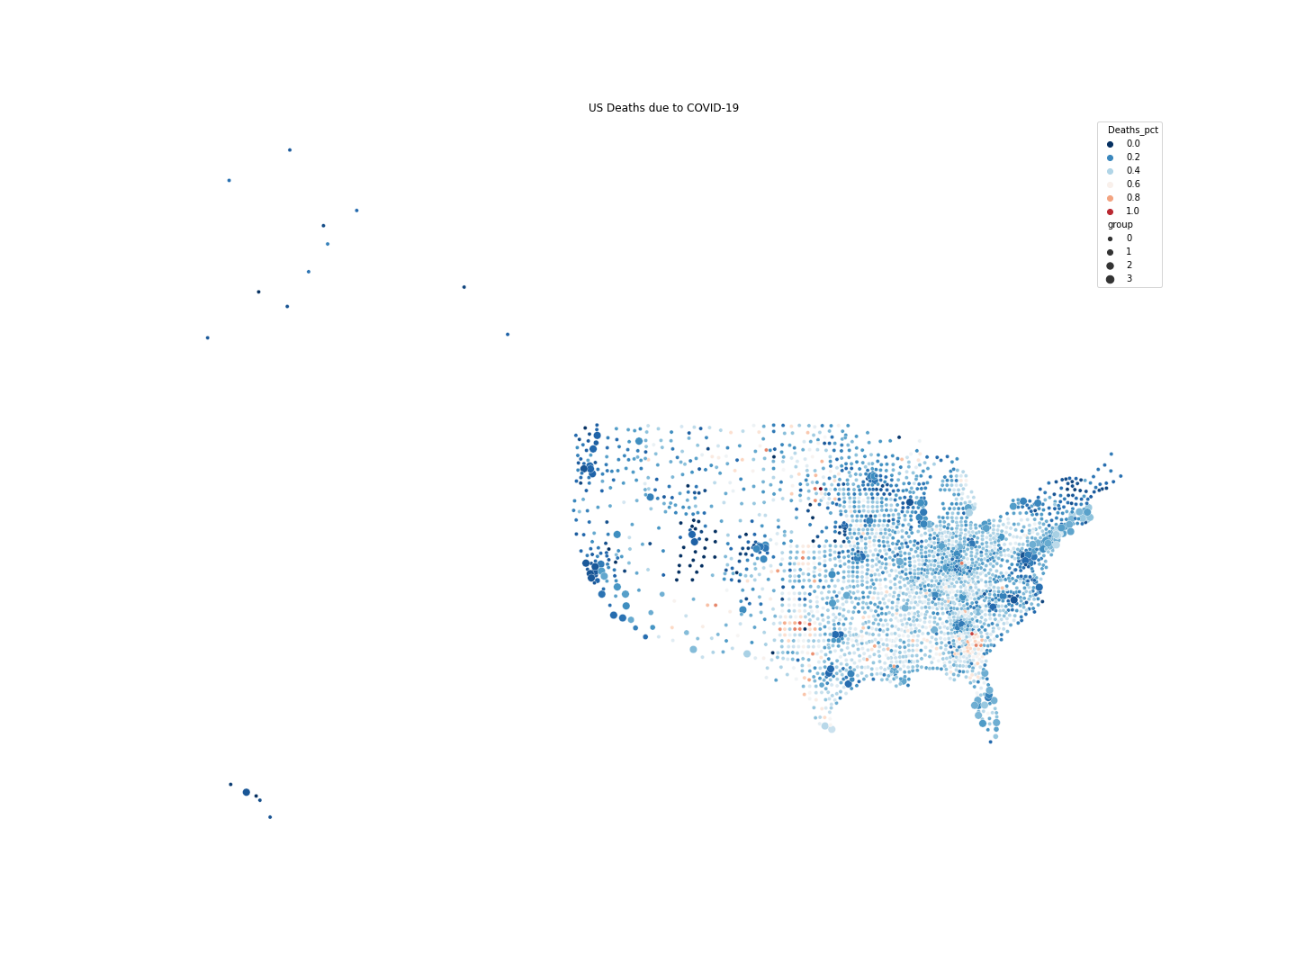
Deaths in the US by County
Notes:
Explain that Grouping has to do with Population size.
Maybe have a zoomed in version w/o Alaska and Hawaii?

Slide 14
Deaths in the US by County
Notes:
Explain that Grouping has to do with Population size.
Precentage of deaths by population is skewed. There appears to be an error in number of cases per population, perhaps in these small counties either there is poor reporting of the number of residents or individuals are counted more than once.
Either way the smaller counties and ones in the more southern and central American States are struggling more with COVID

Slide 15
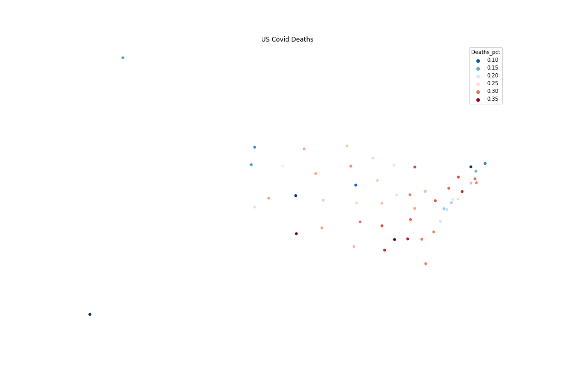
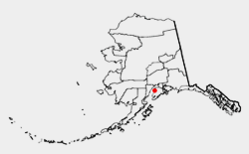
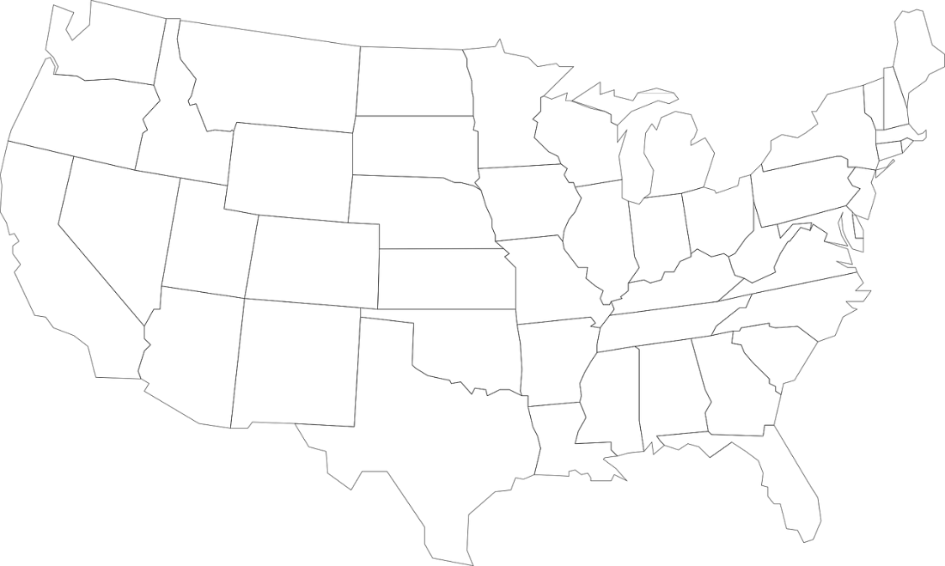
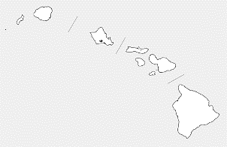
Deaths in the US by State
Notes:
States don’t align with the images that I’ve found.

Slide 16
Regression analysis
K Means Clustering shows us that the data does fall into groups of states/counties which are having different success rates with COVID-19
KNN Regression analysis was tried to see if we could predict the number of deaths in a state based on the defined features

Slide 17
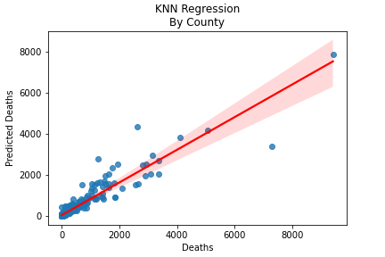
Regression Analysis
KNN Score is 0.8739
Giving us nearly 88% accuracy

Slide 18
Time series analysis
In addition to the data from each state we also have time series data which we could use to predict the outcome of COVID in each state
The data was first made stationary for the analysis
Then a 10 day forecast was predicted to determine if we could predict how COVID would be affecting any particular state

Slide 19
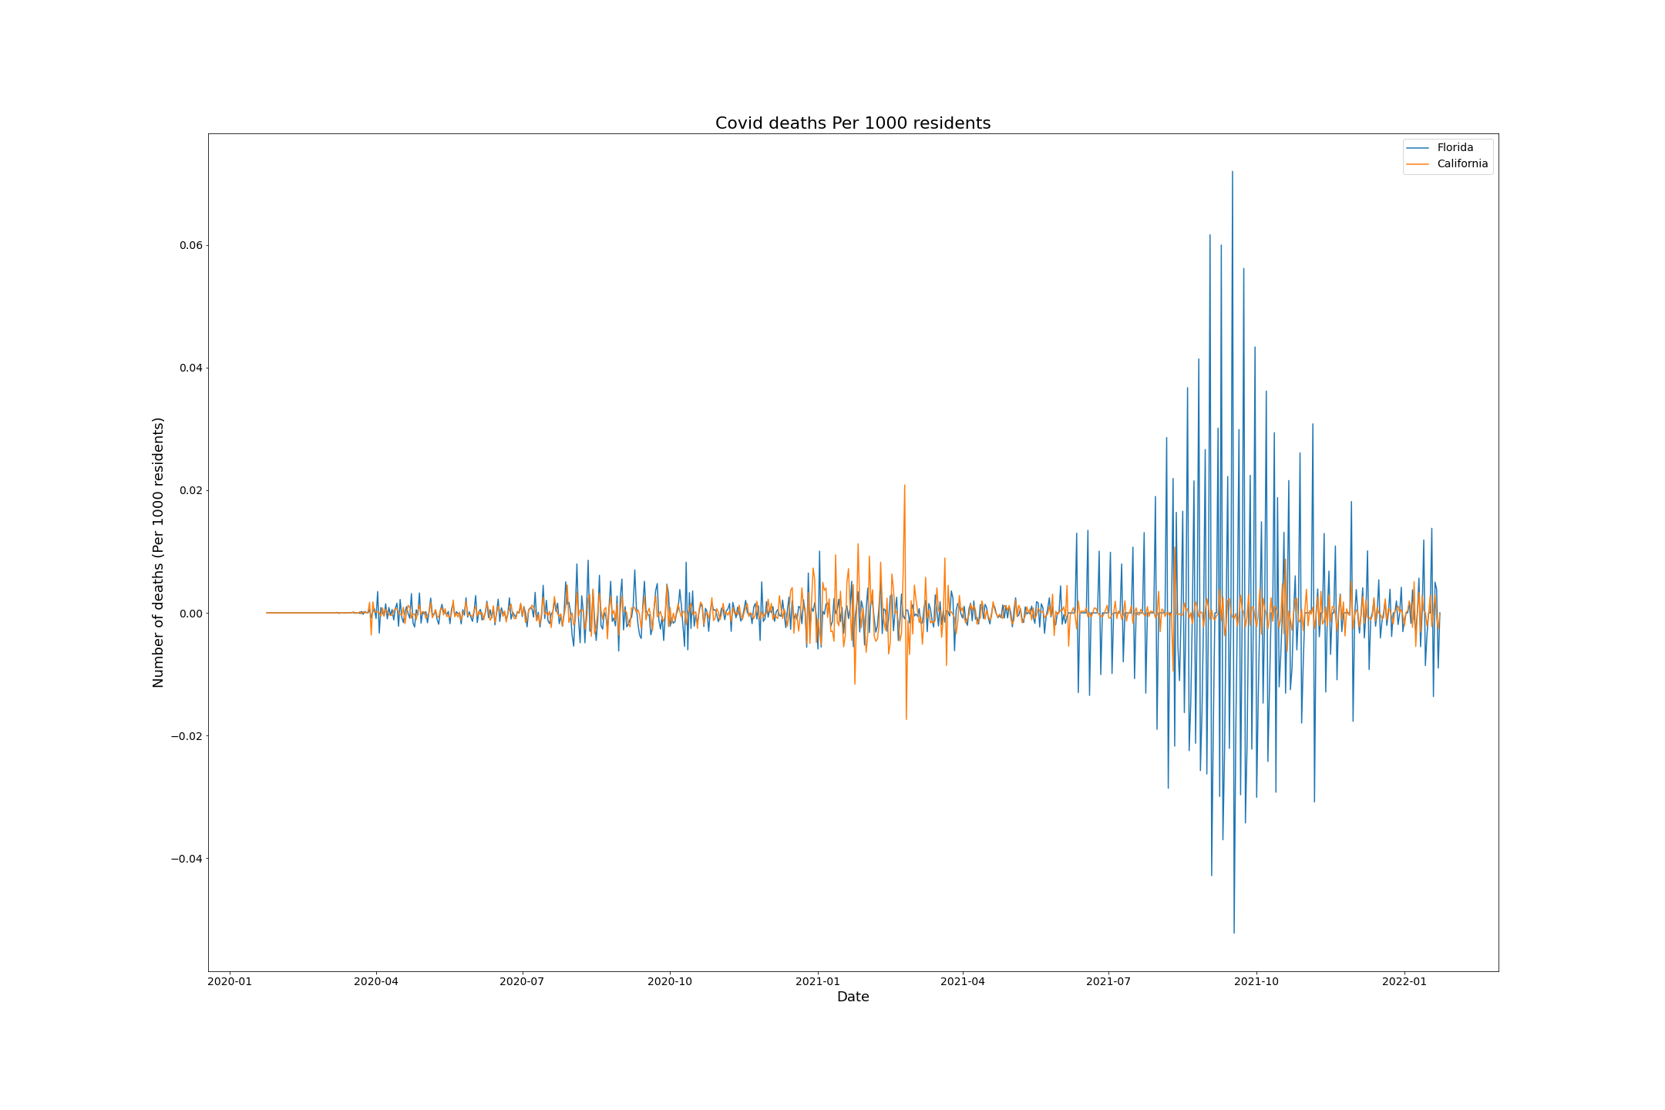
Example of reducing Florida and California data to stationary data

Slide 20
SARIMA Perameters
SARIMAX Results
==============================================================================
Dep. Variable: mov_avg No. Observations: 733
Model: ARIMA(6, 0, 0) Log Likelihood -6330.950
Date: Tue, 26 Apr 2022 AIC 12677.901
Time: 12:34:26 BIC 12714.678
Sample: 01-22-2020 HQIC 12692.087
- 01-23-2022
Covariance Type: opg
==============================================================================
coef std err z P>|z| [0.025 0.975]
------------------------------------------------------------------------------
const 1.031e+04 5575.694 1.850 0.064 -614.065 2.12e+04
ar.L1 0.9927 0.015 64.436 0.000 0.962 1.023
ar.L2 0.0586 0.021 2.848 0.004 0.018 0.099
ar.L3 0.3854 0.021 18.297 0.000 0.344 0.427
ar.L4 -0.4385 0.027 -16.281 0.000 -0.491 -0.386
ar.L5 0.3506 0.021 16.566 0.000 0.309 0.392
ar.L6 -0.3711 0.013 -27.497 0.000 -0.398 -0.345
sigma2 2.19e+06 678.998 3225.552 0.000 2.19e+06 2.19e+06
===================================================================================
Ljung-Box (L1) (Q): 0.72 Jarque-Bera (JB): 139486.43
Prob(Q): 0.40 Prob(JB): 0.00
Heteroskedasticity (H): 72.79 Skew: 1.99
Prob(H) (two-sided): 0.00 Kurtosis: 70.46
===================================================================================

Slide 21
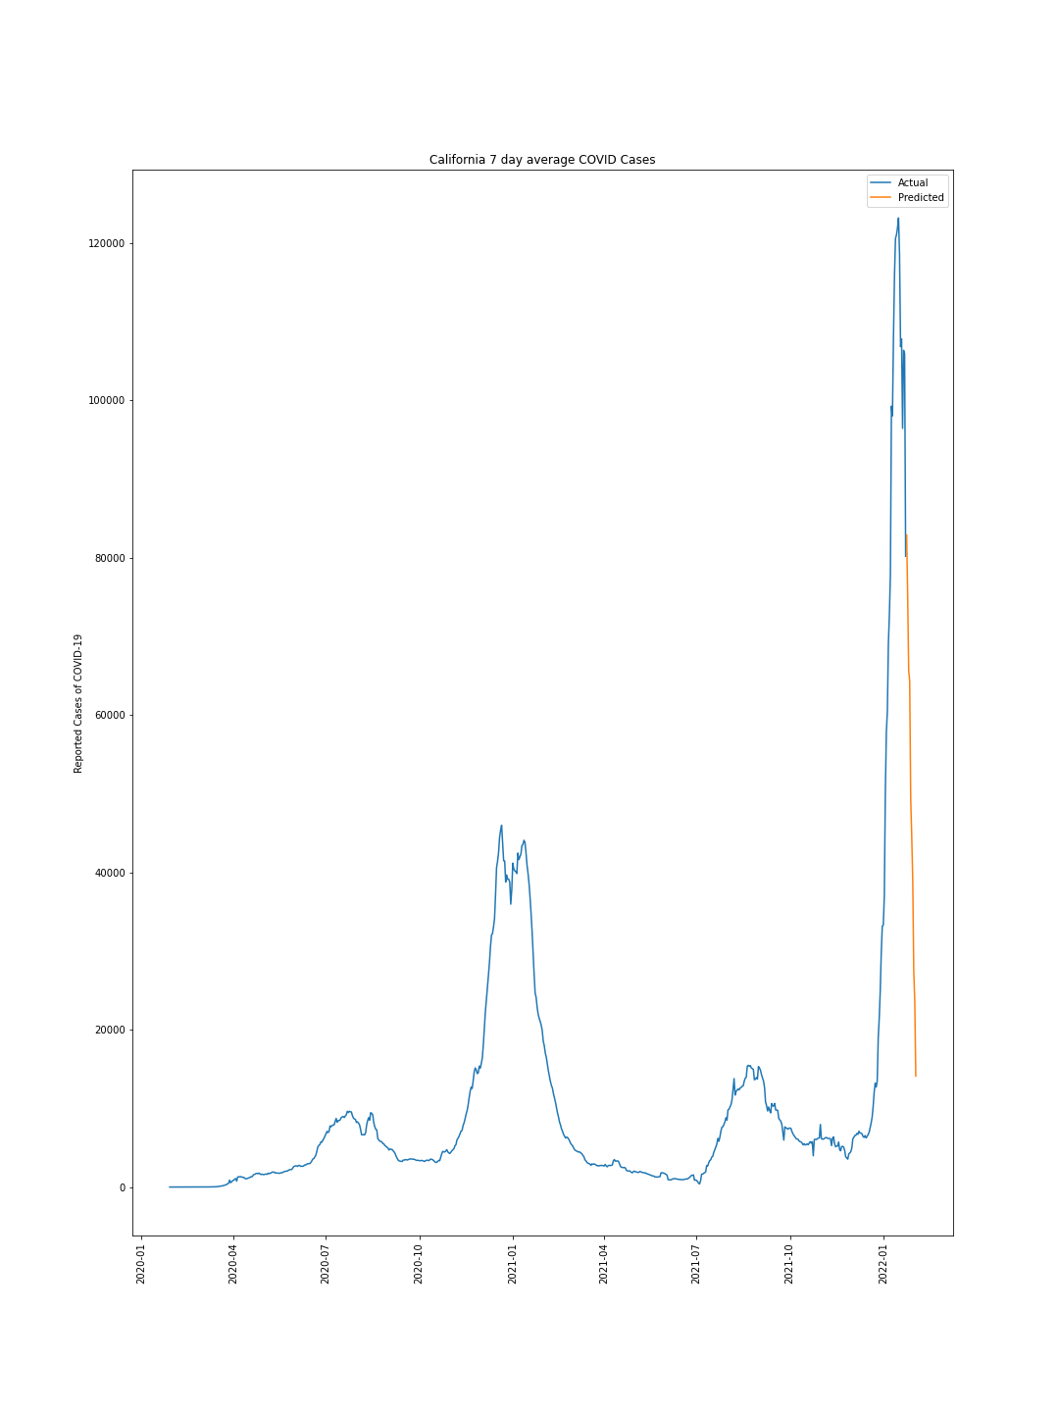
Prediction of California based on 7 day averages

Slide 22
Conclusions
We can predict via KNN Regression the number of deaths associated with SARS-CoV-2 in each state and county based on population, vaccination and number of cases with nearly 88% accuracy
Data for each county seems to have some flaws in calculating actual percentage of individuals who die from COVID-19
Possible reasons:
Additional comorbidities
Individuals getting COVID more than once
Availability of medical treatments may vary in each county/state
Time series analysis seems possible but still needs more work
Vaccination data not incorporated into current time series data
Additional data like dates and compliance with masking and gathering may influence data
For instance temperatures within each county may force people either indoors our outdoors and thus increase their likelihood of transmitting COVID-19

Slide 23
Conclusions
All in all it appears that despite the large size of California it is doing quite well considering the number of people and cases.
Florida, Texas and New York on the other hand have been struggling more relative to their population sizes
Northwestern and Northeastern States appear to be the safest states
Rural counties appear to have the most difficulties with goes in opposition of population density based spread predictions
Vaccination appears to have a negative correlation with both cases and deaths related to COVID-19
Although it is clear that Omicron variant was able to cause more cases despite vaccination coverage
Good news is it does appear to reduce deaths due to SARS-CoV-2

Slide 24
What next?
The next step would be to build the same prediction power seen in our KNN regression with the time series data.
Additional features like hospital capacity, comorbidities, population demographics and even mask mandates and political affiliations could be good predictive features according to some studies
Lastly a color coded map would be a handy tool tip to see where risks lie in each state and county

